Slide 1
Overview of Big Data and HPC
Wrap up Web Scraping
Overview of HPC
Hardware!
Remote Access

Slide 2
What This Lecture Covers:
Wrap up web scraping example
What are “Big Data Analytics” and “High Performance Computing”?
A bit about hardware.
To the cluster, and beyond! (joke)

Slide 3
Big Data Analytics and HPC

Slide 4
What are BDA and HPC?
An approach more than a specific set of tools.
Effort to scale up analysis.
Determining the most efficient way to complete your task (time, resources).

Slide 5
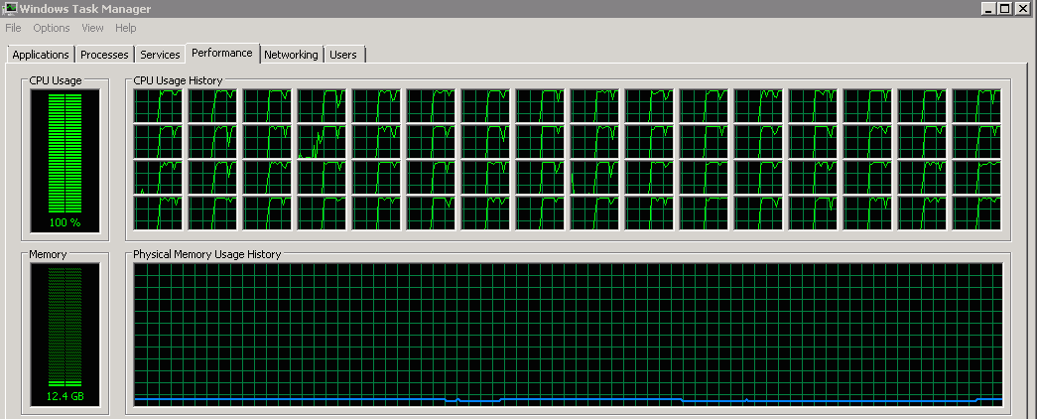
HPC
Run data management task faster.
Work on a larger scale dataset.
Perform more complex analyses.

Slide 6
How Do We HPC?
Use efficient programming languages (C++ works well with R) – hard to learn.
Parallelization – divide and conquer.
Efficient implementation.
Good scheduling (take a nap!).

Slide 7
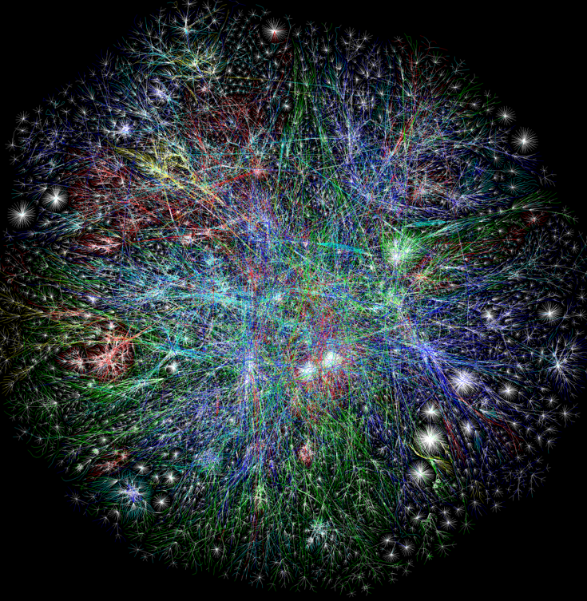
Big Data Analytics:
Work on a larger scale dataset.

Slide 8
Big Data Analytics:
Use memory efficient data structures.
Chunking – work on one piece of dataset at a time.
More RAM (computer memory).
Good scheduling.

Slide 9
How Do They Fit Together?
High Performance Computing
Big Data

Slide 10
Strategy Checklist:
Understand your problem.
Determine which approach is appropriate.
Exercise constraint!
Work smarter, not harder.

Slide 11
Understand Your Challenge:
Large Dataset.
Code takes a long time to run.
Task needs to be replicated zillions of times.

Slide 12
Large Dataset:
First determine memory requirements, what computer will run it?
Use memory efficient data structures (sparse matrices) where possible.
Chunk the problem up.

Slide 13
Long Runtime:
How long? Less than a month? Just wait!
Reliable power supply, turn off automatic updates, save results periodically if possible.
More efficient implementation!
Faster language (C++), should get a collaborator for this to start out.

Slide 14
Many Replications:
Write code to deal with one instance. Test it out.
Break up problem and parallelize!

Slide 15
Hardware

Slide 16
An Overview:
Relevant pieces of hardware.
The different kinds of computers, what they are good for, how much they cost, how much of a pain they are to use.
My two cents on how to spend your money/time, based on your needs.

Slide 17
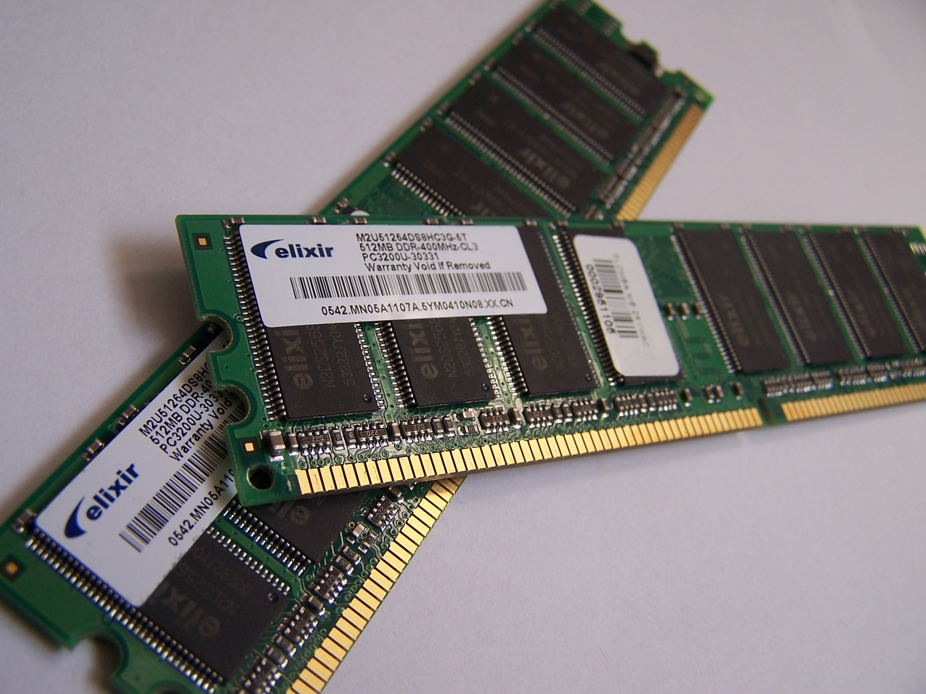
RAM:

Slide 18
RAM:
Allows you to load datasets into R.
Want at least 16GB on a laptop, 64GB on a desktop, but generally as much as you can get.
Determines the scope of projects/datasets you can work on.

Slide 19
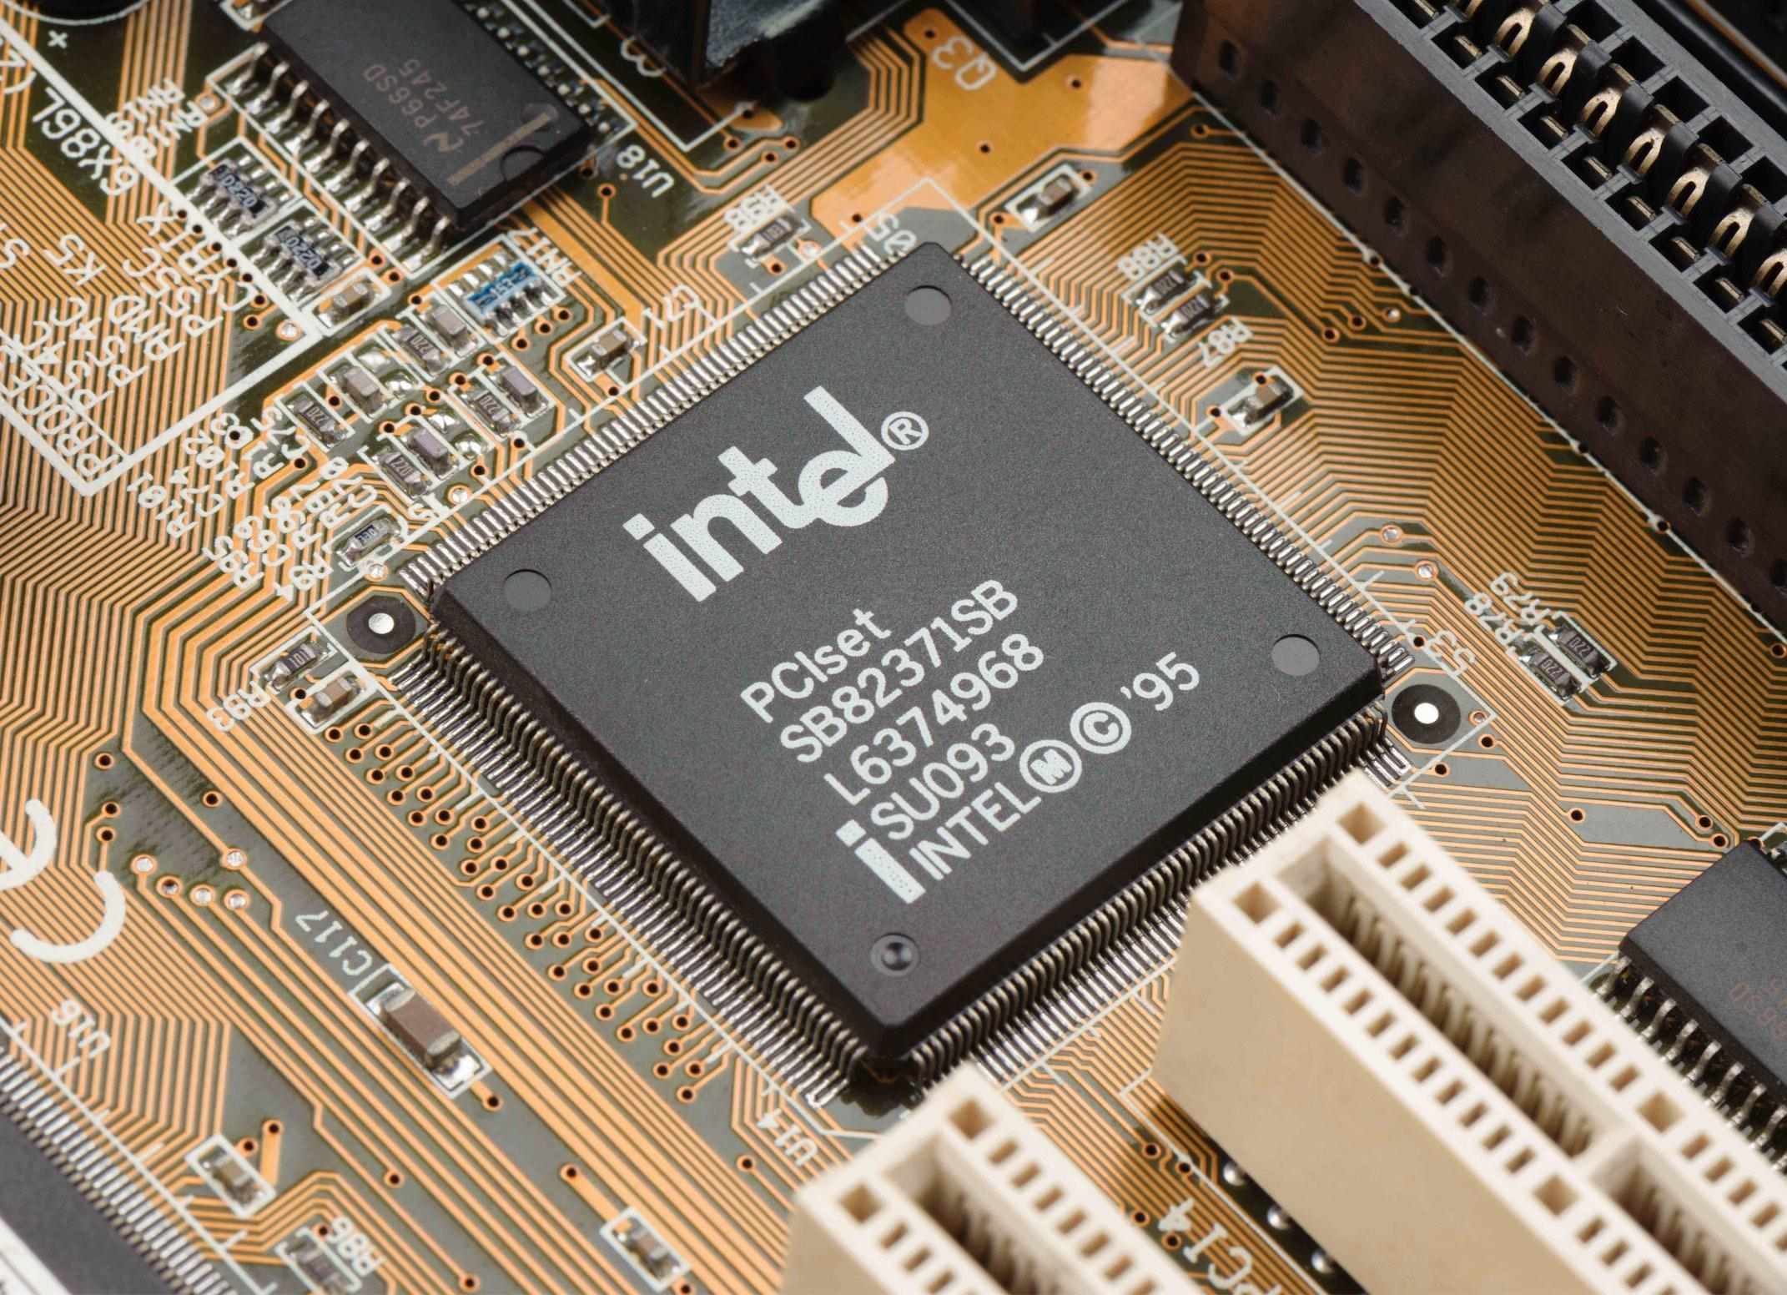
CPU:

Slide 20
CPU:
Allows you to process data, perform calculations.
Higher frequency (faster), more cores (better multitasking).
Want at least 4 cores on any computer.
Determines the speed at which you do things.

Slide 21
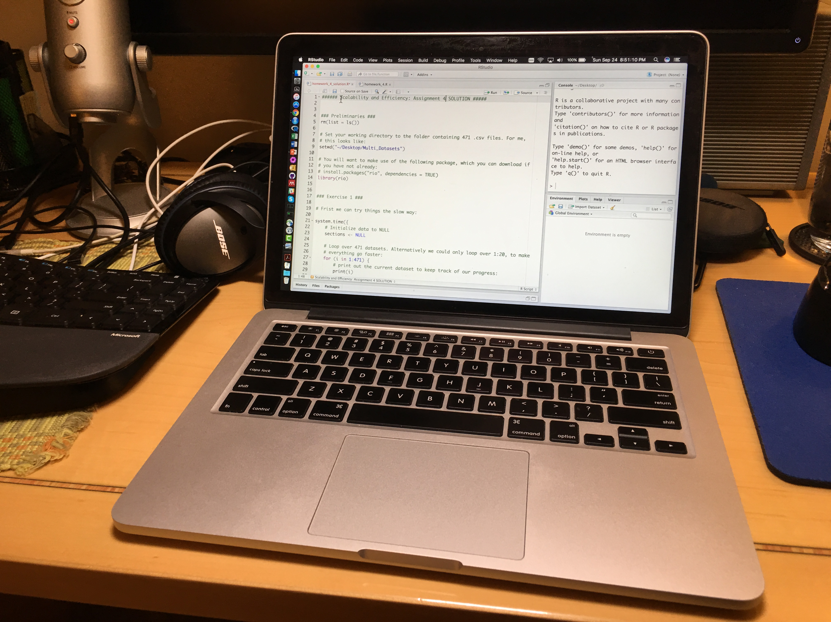
The Laptop:

Slide 22
The Laptop:
Your most important piece of hardware.
Least powerful, most portable, code won’t write itself!
$1000-$4000. Almost always worth spending as much as you can on a laptop.
Unix based operating system (Mac or Linux).

Slide 23
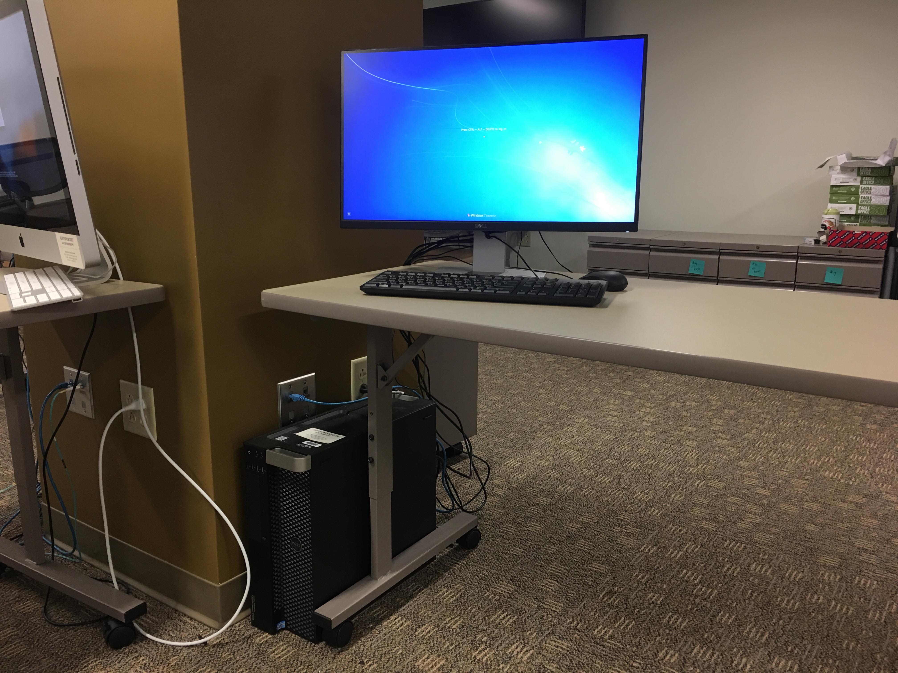
The Desktop:

Slide 24
The Desktop:
More powerful for money, can leave plugged in and working on something for long periods of time (like web scraping).
Look for these in Full Professor’s offices (and borrow them!).
$500-$2000, even cheap ones are useful.

Slide 25
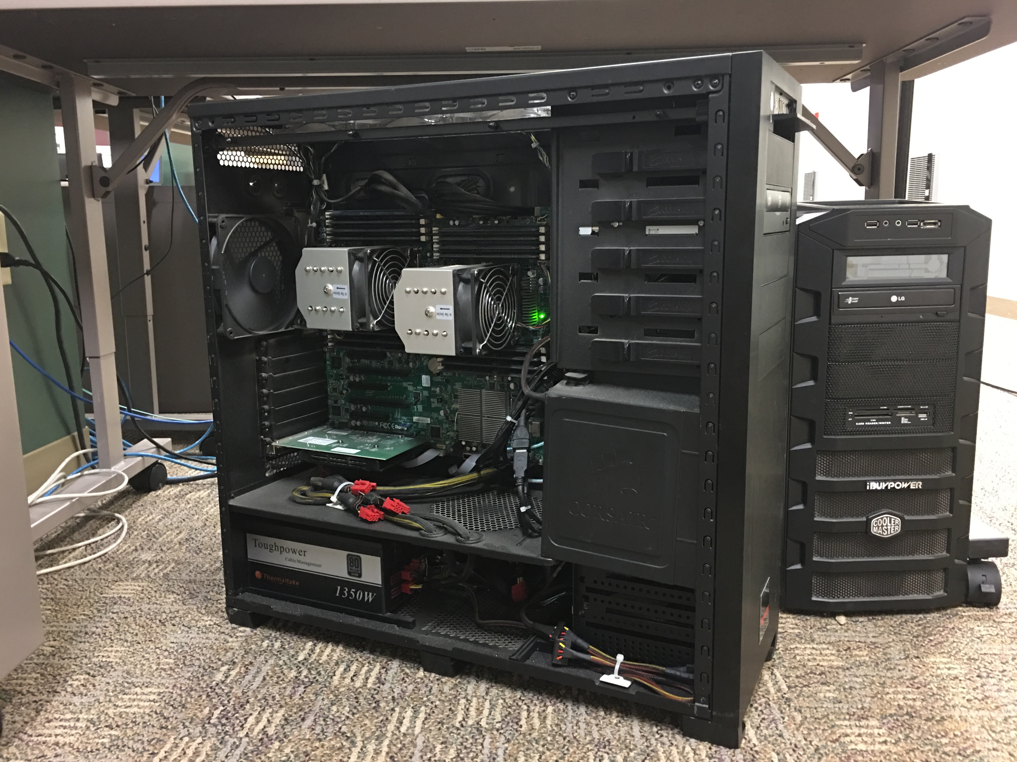
The Workstation:

Slide 26
The Workstation:
Like a super desktop, more RAM, CPU power, hard drive space.
Pain to administer yourself.
$5,000-$20,000+, Cheap ones not really worth it.

Slide 27
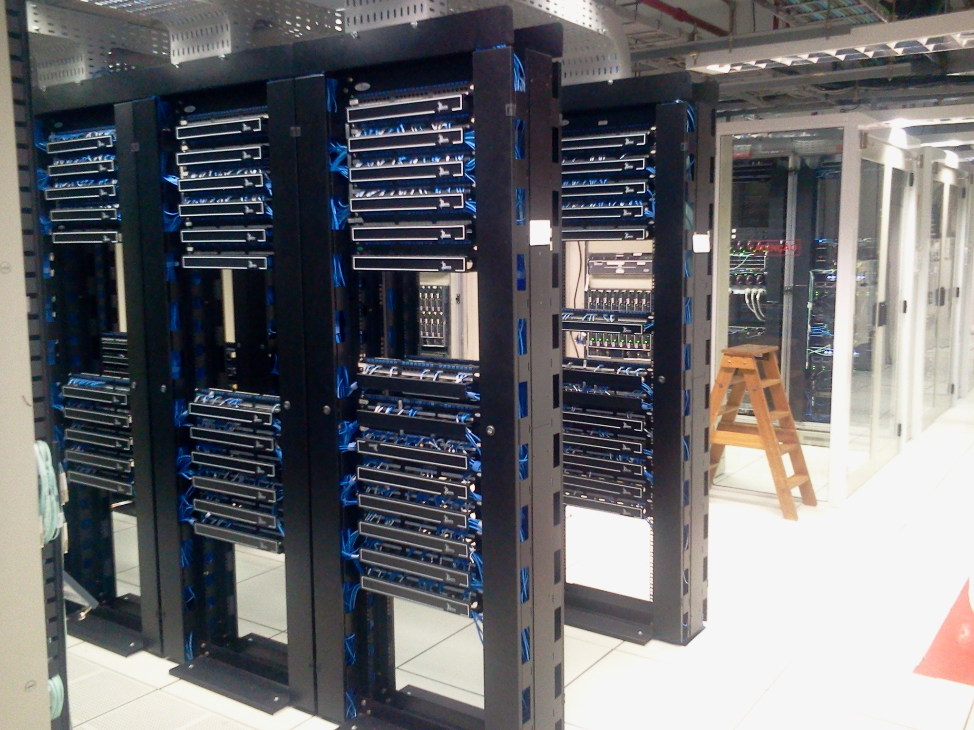
The Cluster:

Slide 28
The Cluster:
Many computers (servers) linked together. Tons of RAM, CPU, great for parallelization.
Someone else has to deal with problems, but you have to wait in line for access.
$ you can’t afford one, your organization will own this, so it is “free” for you.

Slide 29
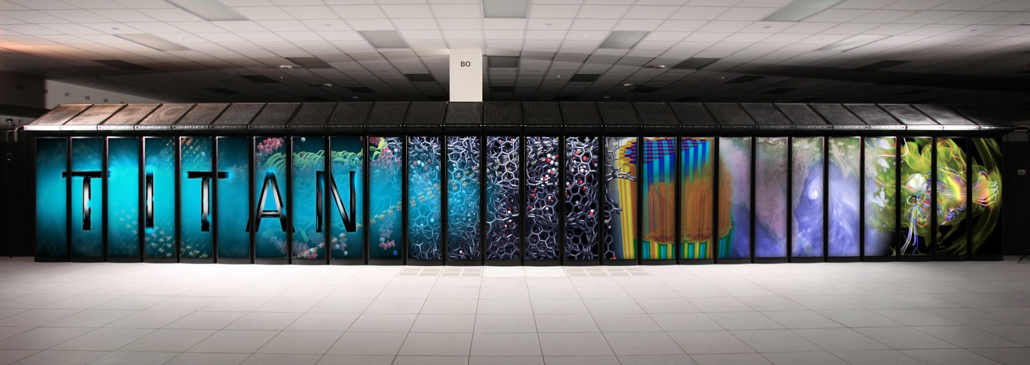
The Supercomputer/Mainframe:

Slide 30
The Supercomputer/Mainframe :
Many computers connected together to work as one unit, useful for complex simulations where parts depend on each other.
Mainframes are for businesses, not research.
You need a cluster, not a supercomputer.
$ hundreds of millions to billions.

Slide 31
My Two Cents:
Buy the best laptop you can afford.
Get access to a desktop (usually free, next thing worth spending on).
Get access to cluster (free).
Other than that, money better spent on other things! You will really know if you need more.

Slide 32
Remote Access

Slide 33
Remote Access Explained:
Control a powerful desktop/ workstation/ server from your laptop remotely.
Big computer does the “heavy lifting”.
RStudio server or ssh.
Security is paramount, I have been hacked!

Slide 34
RStudio Server

Slide 35
SSH – Command Line Access

Slide 36
Accessing “The Cluster”:
Penn State has a big cluster.
Often these are under-utilized, so lots of support to use them.
Get training from the administrators, then complain if things do not work (sweet!).
Command line interface, will need to use terminal.

